Slide 1
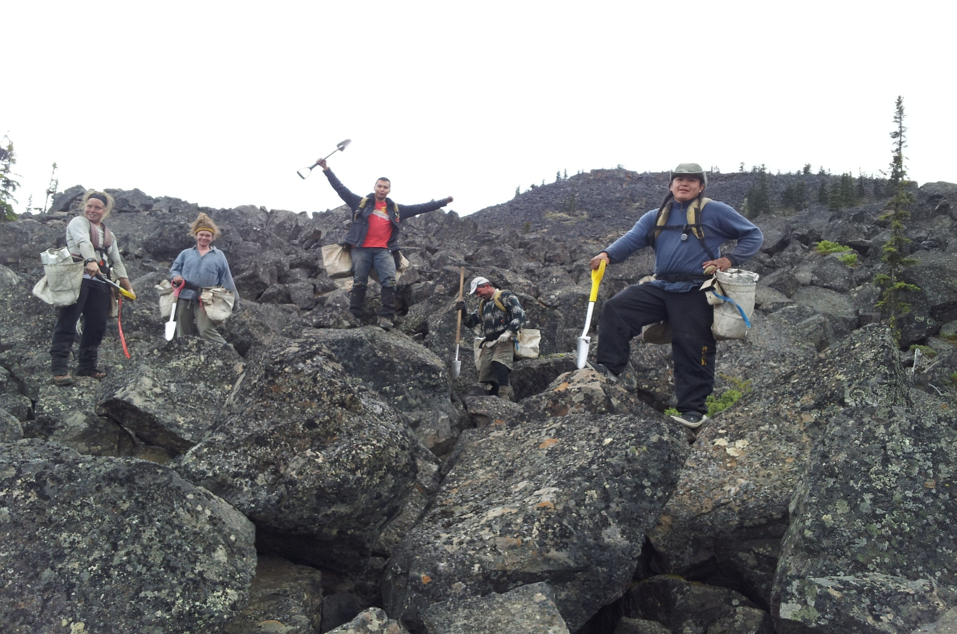
Forests For Tomorrow
Species and sowing
Provincial Meeting
September 18, 2013
Allan Powelson
Photo by Leon Duncan

Slide 2
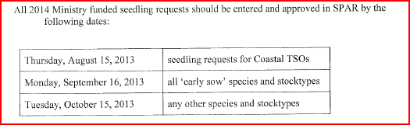
Strongly encourage the use of Plantwizard to assist in Sowing and planting planning
Notes:
‘Early Sow’ Stock Types
• 1 + 0 ‐ Yellow Cedar (Yc) seedlings or cuttings
• 1 + 0 ‐ White Pine (Pw)
• 1 + 0 ‐ Amabilis Fir (Ba)
• 1 + 0 ‐ Subalpine fir (Bl)
• 1 + 0 ‐ Noble fir (Bn)
• All species and stocktypes for planting in 2014 summer or 2014 fall
All species and stocktypes for transplanting in 2014 summer (half year transplants)

Slide 3
Target of 20 Million seedlings for planting in 2015/16
  Must take into consideration sowing of summer stock in 2014 (historically 1.5 million)
  FFT is striving to be a leader in species and density management

Slide 4
Species management and density targets
Objectives of the FFT management of tree species composition
Species mixtures will be planted,
  Where appropriate, and to the degree reasonable:
    areas will be planted with a mixture of desirable species; and
    on sites with more than one "preferred" species, more than one preferred species (and, where practicable, all of the preferred species) will be planted.
Species management decisions will be informed by forest-level analysis.
  FFT species management will be informed by analyses of the long-term, forest-level impact of species choices, where these analyses are available.
Cumulative impacts, and impacts at the landscape scale, will be considered.
  Where appropriate, and to the degree practical, FFT will work to improve watershed and landscape composition.
  Where young stand composition is known to deviate from natural composition (as a result of past management), FFT treatments will help to re-establish natural composition.
Density management will optimize productivity, future product value, and resiliency of the forest at a stand and landscape level.

Slide 5
FFT Species and Density Indicators
Percent of area planted with more than one tree species
Opening area weighted mean dominant species percent in the inventory label at establishment, regeneration delay, and free growing.
Percent of area in a management unit planted with a single species
Percent of area post-treatment stand composition that is single species
Average opening well-spaced density at establishment, regeneration delay, and free growing.

Slide 6
Species and Density Targets
Professional decisions to deviate from the objective will be recognized in those situations where it is ecologically appropriate (i.e. forest health- rusts, frost, weevil, root rot, the site being a complex of more than 1 site series, etc).
80 % of the area planted within a management unit, where funded by FFT, should have more than one species in the silviculture label at the time of establishment

Slide 7
In ecosystems with more than one preferred species, where practicable, no one species should comprise more that 70% of the composition of the inventory label of an opening area at establishment, regeneration delay, and at free growing.

Slide 8
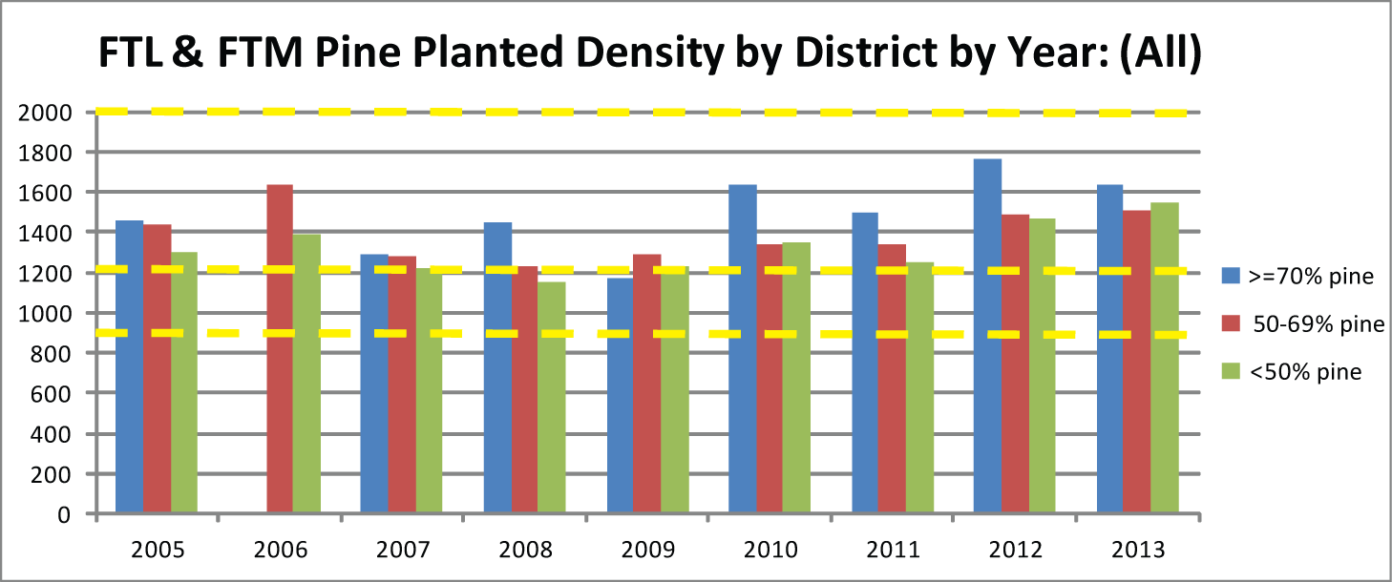
Establishment and regeneration delay density management target well-spaced stocking of, at least, 1200 sph (interior) and 900 sph (coast) for non-lodgepole pine dominated stands and, at least, 2000 sph for lodgepole pine dominated stands (i.e. > 50 % of the species mix is lodgepole pine) at free growing declaration.

Slide 9
Other guidance to consider
Encouraging conifer mixtures
  Guidance on incorporating conifers mixtures into plantations
Assisted migration guidance
  covers the assisted movement of species into biogeoclimatic zones/subzones where they are not currently considered as preferred or acceptable in response to anticipated climate change
FFT use of White Pine guidance
  where feasible and ecologically appropriate to do so white pine blister rust resistant western white pine seedlings will be incorporated into the planting mixture for FFT funded reforestation activities
Silviculture regimes for fuel management
  Altering treatment prescriptions to accomodate fuel management goals
Fibre plantations in BC
  Develop new wood product opportunities, such as bioenergy and other wood-based fibre based products, from a limited land base

Slide 10
